Slide 1


Research Sparks
Sparking conversations among postgraduate and early career researchers
Kim Davis (Information Specialist)
Tara Healy (Open Research Specialist)
Notes:
Hello, I'm Kim and I'm an Information Specialist working with science subjects and within our research support team, and this is Tara our dedicated Open Research Specialist.
We're here to tell you more about our Research Sparks sessions and how they are working to change research culture at the University of Plymouth.

Slide 2
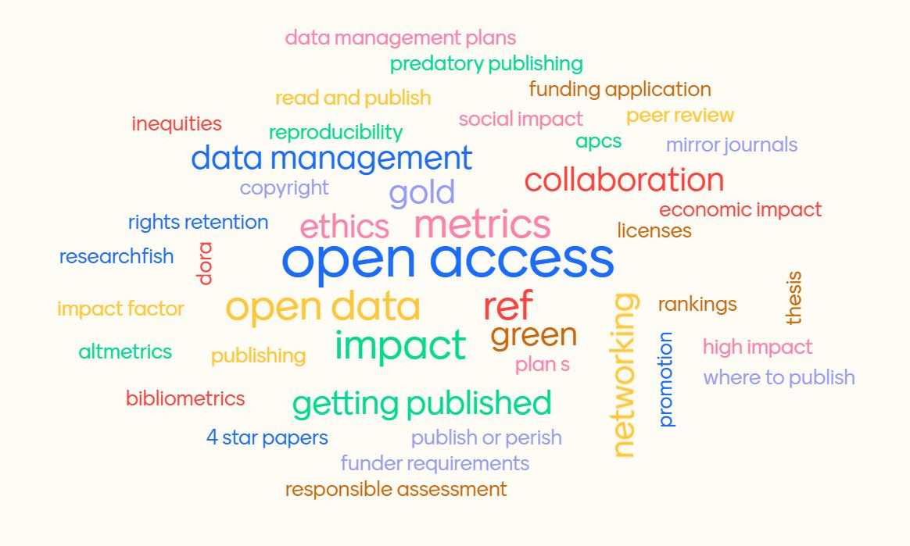
Are researchers aware of the wider research environment?
Notes:
A 2015 JISC report suggested that PGRs may finish a research degree with little awareness of a networked information/research environment.
With the limited teaching time we have, it is hard to teach the complex, interconnected research landscape and attendees prefer our taught sessions when they deliver skills or information they can apply directly to their work.

Slide 3



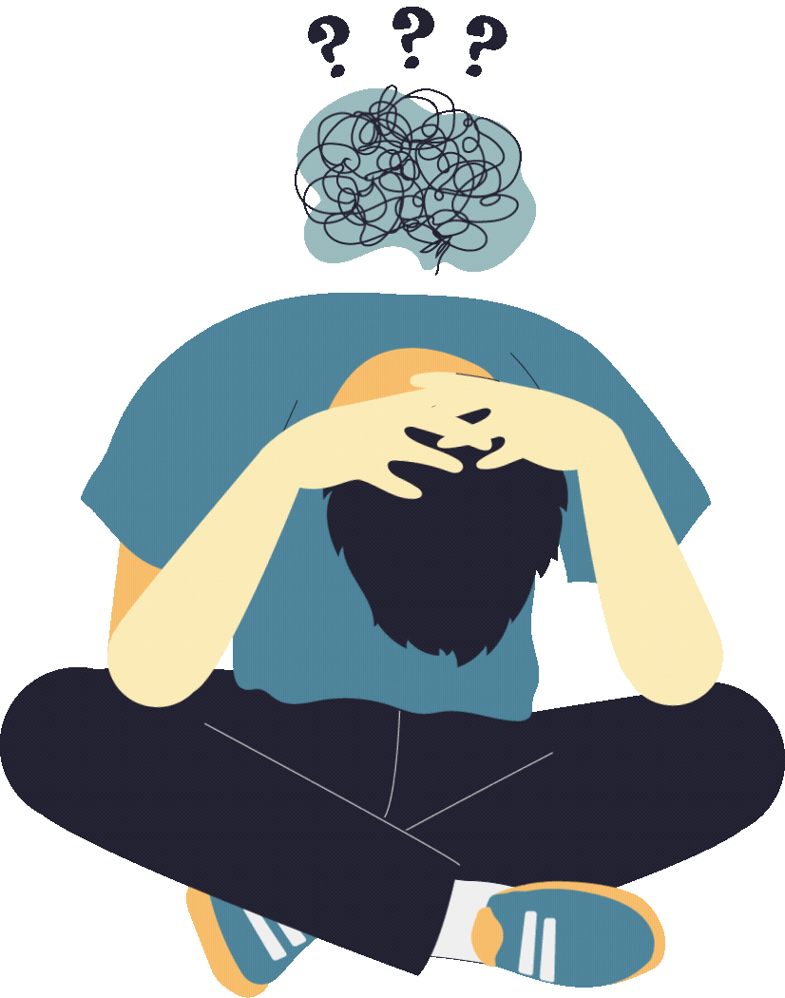
"I prefer to conduct the sessions in person once more.
I'm bored of online training."
- 2022 UoP PGR/ ECR Survey
"...satisfaction levels are lowest, and have fallen,
among PGRs who interact exclusively online"
- 2022 PRES sector results report
Increasing face-to-face opportunities for postgraduate and early career researchers
Notes:
Post-pandemic we are still conducting a lot of business online and most of our researcher training is still via zoom, which is popular among most PGRs.
However, both the 2022 PRES survey and our own in-house PGR/ECR survey reflected some appetite for more in-person events.
Additionally, departments may be operating in echo-chambers of a particular research culture, and PGRs might naturally follow their colleagues over any behaviours we try to promote.

Slide 4















Transformative sustainability learning- space to change
Notes:
Transformative sustainability learning could help us teach some of the wicked problems in the research landscape.
Forming trans-disciplinary spaces for dialogue on topics and providing opportunities to imagine alternative solutions outside of power structures, could allow researchers to learn new ways of working from us and each other.

Slide 5




Research Sparks
Informal, discussion led
Sparking conversation
Changing research culture
We act as facilitator
We provide space, hot drinks, biscuits
Meeting new people and finding new ways of working
Notes:
They could then take what they learn back to their departments.
This idea became Research Sparks. We hoped that exposing researchers to new developments in the landscape and providing an informal space to share ways of working with peers, could influence research culture at the University of Plymouth.

Slide 6
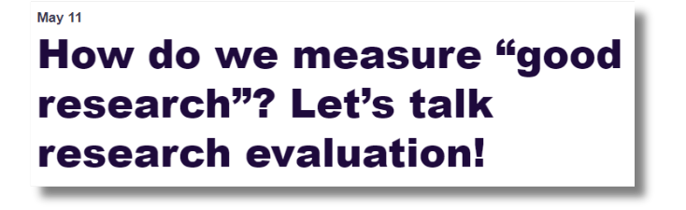


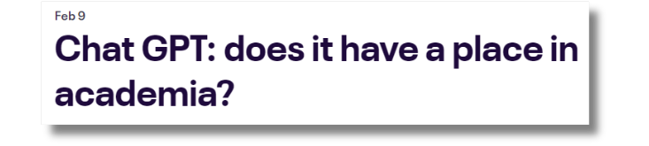
'Sparking' debate
Notes:
When we were choosing topics for these sessions we considered ideas that could influence the future careers and culture of the next generation of researchers.
We also selected 'controversial' topics or things that we thought would be likely to generate healthy debate between disciplines and encourage them to reassess their own experiences preconceptions.

Slide 7
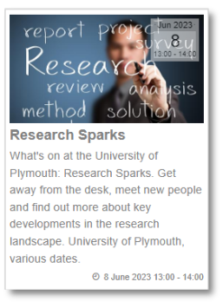
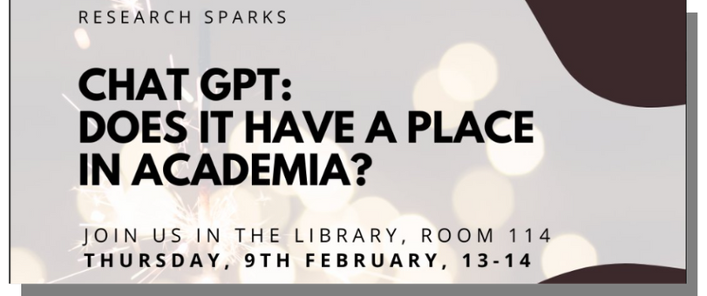
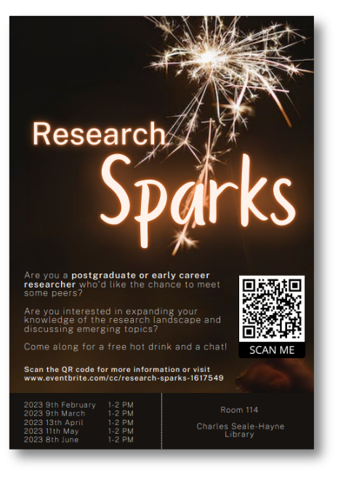
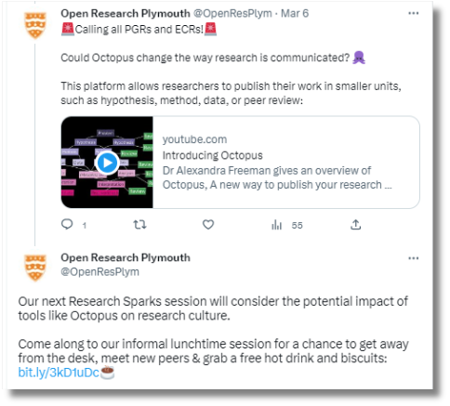
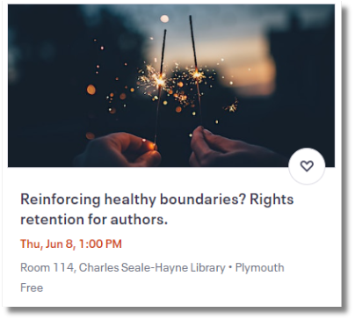
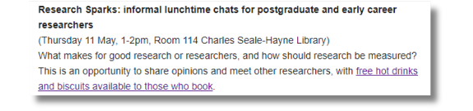
Notes:
We advertised these sessions as heavily as we could across social media, emails, events pages, and so forth.
We also put up posters in recreational spaces across campus such as cafés, partially to attract more attention, but also to help communicate the social aspect of these sessions.

Slide 8

Structuring Sparks
Notes:
We also got advice from student learning services on how we could structure the sessions in a way that would encourage people to engage more actively in the conversations.
One really useful tactic they suggested was to start the sessions by asking the researchers what they already knew about the topic before giving them any more information and this got them talking among themselves from the get-go.

Slide 9

Measuring impact
You're not under scrutiny here...
  Rejected 'before-and-after' quizzing on topics as a way of measuring impact
  Any feedback needed to be light-touch and optional
Notes:
There were some suggestions that we decided against, though, for example getting all attendees to answer questions before and after the session to measure how much they had learned on the topic.
However, we decided on balance that for these particular sessions our priority was to encourage an informal atmosphere and avoid them feeling like they were under scrutiny.

Slide 10
Measuring impact
You're not under scrutiny here...
...but was it useful?
  What do you feel you gained from today?
  Would you like more opportunities to meet researchers from other disciplines?
  Would you be more likely to talk to peers or colleagues about the topics we discussed today, as a result of attending this session?
  Rejected 'before-and-after' quizzing on topics as a way of measuring impact
  Any feedback needed to be light-touch and optional
Notes:
We did send out a very short survey by email after each session which many of them filled out voluntarily and this helped us to evaluate what our attendees felt they’d gained from the sessions, either socially or educationally.
We also asked them to indicate whether they would be more likely to talk to peers about the topics we’d covered, since this could indicate an impact on research culture at Plymouth.

Slide 11

The discussions changed opinions
"I gained a new (more positive) perspective, possibly some stronger skills"
" I have a feeling I will need to use it [ChatGPT] in the near future, as a tool to support my research"
Notes:
Some of the discussions were lively and a few participants came out with changed perspectives, particularly during the Chat GPT session. Do we want more researchers to use ChatGPT? The jury is still somewhat out on that one, but it is clear that peer-led discussion can be influential in changing research practice.

Slide 12

Researchers learned from those at different career stages
“My knowledge of metrics was zero so I feel that I've learnt a lot!!! It's always nice to learn about what I think of as PhD level stuff, because it seems very overwhelming from my ResM.”
Notes:
ECRs sometimes had more to say on topics (e.g. Research Assessment) than PGRs who might be at an earlier stage of their career. This shone a light on future training needs to PGRs, and probably promoted the sessions in our regular training offer better than we ever could.

Slide 13

Disciplinary differences shaped conversations
“I got to understand how people in other disciplines feel about ChatGPT”
“...there was some debates with very different viewpoints...”
Notes:
The conversations were made more dynamic by the fact that different research areas had varying opinions on some topics; for example, data scientists generally had more positive opinions of ChatGPT.
Marine science is one of Plymouth’s main research strengths, so it was interesting to see that even early career researchers in that subject had particularly strong views on things like research assessment.

Slide 14

“I feel like having a very informal discussion was actually helpful as opposed to a structured session, we got to jump around topics”
The session structure helped learning
“I feel I learned about GPT from my peers in the room, it was interesting to hear their opinions”
Notes:
We also found that the social learning we were aiming for really was helped by the flexible structure of Sparks.
We saw both during the sessions and in our feedback that attendees really enjoyed these open-ended discussions which let them focus on the areas they were interested in and exchange ideas more freely.

Slide 15
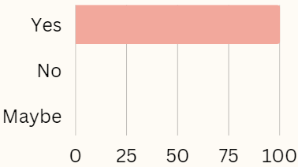
Overall feelings were very positive
"Would you be more likely to talk to peers or colleagues about the topics we discussed today?"
Notes:
The survey also confirmed that the participants appreciated the social aspect of these events and that they would be interested in attending similar sessions in the future - and we did see some recurring faces at Sparks.
They also unanimously answered ‘yes’ when asked whether they’d be more likely to discuss the chosen topics with peers after attending Sparks.

Slide 16
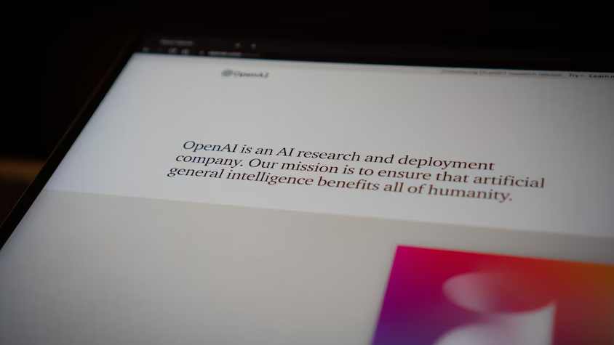
We learned a lot about our researchers...
Notes:
It’s no surprise that hosting Sparks also taught us a lot about our own researchers.
One really interesting outcome came from the discussions we had around ChatGPT where we learned about how our researchers had been using it for research analysis; these conversations ended up informing a level of nuance the University’s official stance on both the uses and limitations of generative AI.

Slide 17

It was valuable to be able to listen- we could spot new needs to develop our training and service offer
Notes:
We quickly learned the potential for us to gain a lot from listening to these new perspectives.
One researcher described difficulties in pitching their interdisciplinary research to journals with different scopes and felt that a platform like Octopus could remove that barrier to dissemination.
We could potentially use what we learn to spot new needs and develop our training and service offer.
Naturally we have also had some hiccups...

Slide 18

Mistimed sessions, event clashes, failing to make ideas relevant, not promoting enough....
Notes:
Funnily enough, researchers go away at Easter so putting a session then was a bad idea.
We also learned the hard way that just because an idea is new or interesting to us, does not mean the audience care about it.
We took what we learned and applied it to our last session on researcher assessment by avoiding jargon, making it sound relevant to researchers and increasing promotion heavily and this did result in more sign-ups.

Slide 19

Going forwards- from sparks to flames
Notes:
Following on from this, we plan to get attendee input on topics for future sessions and work harder to spot trending topics in news from our networks.
We’d like to change the location of the space, which is a teaching room and does not support discussion to the extent we want.
We also need to consider long-term evaluation of the project, such as measurable progress questions from regular attendees.
All recommendations would be welcome!

Slide 20

Thank you
for listening
Kim Davis- Kim.Davis@plymouth.ac.uk
@Kiminthelibrary
Tara Healy- Tara.Healy@plymouth.ac.uk
@_tarahealy
Image Credits
  Slide 3- Photo by Daniel Thomas on Unsplash
  Slide 5- Photo by Alex McCarthy on Unsplash
  Slide 8- Photo by Matt Botsford on Unsplash
  Slides 9 & 10- Photo by Jakub Dziubak on Unsplash
  Slide 16- Photo by Johnathan Kemper on Unsplash
  Slide 17- Photo by Ashin K Suresh on Unsplash
  Slide 18- Photo by Sarah Kilian on Unsplash
  Slide 19- Photo by Jonas Von Werne on Unsplash
Notes:
Literature:
Education for Change (2015) Researchers of Tomorrow: The research behaviour of Generation Y doctoral students. Joint Information Systems Committee. Available at: https://www.jisc.ac.uk/reports/researchers-of-tomorrow (Accessed: 02/12/2022).
Neves, J. (2022) Postgraduate Research Experience Survey 2022: sector results report. York, UK. Available at: https://www.advance-he.ac.uk/knowledge-hub/postgraduate-research-experience-survey-2022 (Accessed: 02/12/2022).
Tomkinson, B. (2009) ‘Coping with complexity: the ability to manage complex sustainability problems’, in Stibbe, A. (ed.) The handbook of sustainability literacy : skills for a changing world. Totnes, Devon: Green Books, pp. 165–170.
Wahls, A. E. J. and Blewitt, J. (2010) ‘Third-wave sustainability in Higher Education’, in Jones, P., Selby, D., and Sterling, S. R. (eds) Sustainability education perspectives and practice across higher education. London: London, pp. 55–74.

